Slide 1
Touch Typing Course Part 3

Slide 2

Content
After finish the lesson student will be able to:
Typing without watching their keyboard smoothly from letter A-Z
Capital letters and period
C and comma

Slide 3
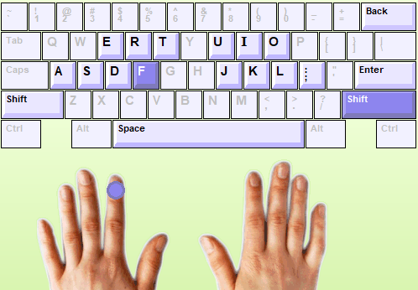
Capital Letters and Period
We use Shift key + letter= Capital letter by:
Hold Shift with right little finger
Press “F” with left index finger
Notes:
Desktop can’t move during using because no power supply
Laptop can move to everywhere because it has power supply

Slide 4
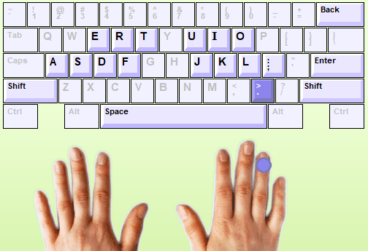
Capital Letters and Period
The keys period located below the home row. Key period is typed using the right ring finger.
Notes:
Desktop can’t move during using because no power supply
Laptop can move to everywhere because it has power supply

Slide 5
Practice
1). Turn on your computer
2). Login into Typing Master with your account
3). Start to typing on “lesson Five= Capital Letters and Period”
New keys Shift = 5 min
Word drill = 5 min
New Keys Period = 5 min
Sentence drill= 2 time (5x2=10min)
Paragraph drill= 2 time (5x2=10min)
Lesson exam = 10min
Students follow with instruction from Teacher one by one.
Notes:
Let them do it

Slide 6
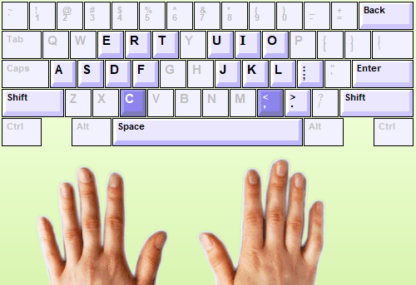
C and Comma
The keys C and comma located below the home row. C and comma are typed using the Middle Fingers.
Notes:
Desktop can’t move during using because no power supply
Laptop can move to everywhere because it has power supply

Slide 7

Practice
1). Continue to the next lesson Six “ Keys C and Comma”
2). Start to typing with instruction below:
New keys: C ,= 5 min
Word drill = 2 time ( 3x2=6 min)
Bubbles game= 4 min
Word drill= 5min
Sentence drill= 5 min
Paragraph drill= 2 times (5x2=10min)
Lesson exam = 10min
Students follow with instruction from Teacher one by one.
Notes:
Let them do it

Slide 8
HOMEWORK
Student Need to finish home work both in chapter Five and Six in Typing Master before next session by complete “ Lesson Exam”.
If you not complete, you can’t continue to the next chapter.
So it mean you need to qualify with speed in 10 min:
Less 15 wpm = 45 ( can’t continue)
15-19 wpm= 50
20-24 wpm = 60
25-29 wpm = 70
30-34 wpm =80
35-39 wpm = 90
40 up wpm= 100
Note: Teacher can check all your record typing. Do your best!

Slide 9

Login to Typing Master by your account
Open lesson 6 “ Lesson Exam” in Typing Master
Your full score 40wpm= 100pts

Slide 10

Any Question ????

